Slide 1

Urban Acoustics
Week 6 Tutorial
Cnossos model prof.dr.ir. Maarten Hornikx dr. Matthias Cosnefroy

Slide 2
Cnossos
Problem :
A residential area is located close to a highway. The façade of the closest house is 110m from the center of the highway. The road has a total vehicle flow of 4000 vehicles per hour which is composed out of 90 % lightweight and 10 % heavy duty vehicles. The lightweight vehicles have a speed of 120 km/h and the heavy duty vehicles a speed of 80 km/h. For the source, a height of 0 m can be used. The ground between the road and the residential area is of the type compacted lawn and the highway asphalt type ‘very hard and dense’. We consider the highway as a line source and the speed of sound is 340 m/s.
a) Compute the sound power L_{W,eq,i,m} of the highway for the 1/1 octave band range 63-4000 Hz, per vehicle type. Also, compute the total sound power L_{W,eq,i} for the vehicles together.
7S0X0
2017/02/09
PAGE <number>

Slide 3
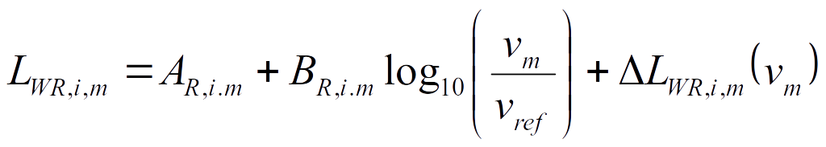

Cnossos
a) Compute the sound power L_{W,eq,i,m} of the highway for the 1/1 octave band range 63-4000 Hz, per vehicle type. Also, compute the total sound power L_{W,eq,i} for the vehicles together.
Answer:
For both the lightweight vehicles (m=1) and the heavy vehicles (m=3), we first use the next formulae to compute the sound power from rolling noise (L_{WR,i,m}) and propulsion noise (L_{WP,i,m}) emitted by one vehicle, for each octave band:
You just have to find the coefficients associated with each vehicle type (for each octave band)
7S0X0
2017/02/09
PAGE <number>

Slide 4
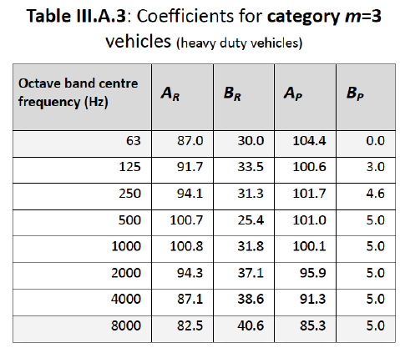
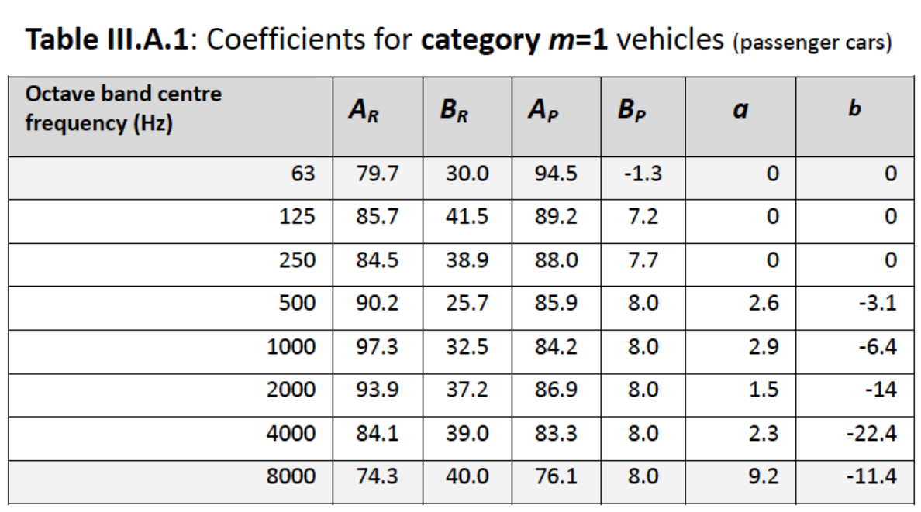
Cnossos
a) Compute the sound power L_{W,eq,i,m} of the highway for the 1/1 octave band range 63-4000 Hz, per vehicle type. Also, compute the total sound power L_{W,eq,i} for the vehicles together.
Answer:
For light vehicles, use v₁ = 120 km/h, v_{ref} = 70 km/h, ΔL_{WR,i,1} = 0
For heavy vehicles, use v₂ = 80 km/h, v_{ref} = 70 km/h, ΔL_{WR,i,2} = 0
7S0X0
2017/02/09
PAGE <number>

Slide 5
Cnossos
a) Compute the sound power L_{W,eq,i,m} of the highway for the 1/1 octave band range 63-4000 Hz, per vehicle type. Also, compute the total sound power L_{W,eq,i} for the vehicles together.
Answer:
Once you know the sound power from rolling noise L_{WR,i,m} and propulsion noise L_{WP,i,m} for each octave band and each vehicle type, compute the total sound power per vehicle (logarithmic sum):
You can then compute the sound power per meter associated with the flow of type-m vehicles as
With Q₁ = 3600 light vehicles per hour
and Q₃ = 400 heavy vehicles per hour
7S0X0
2017/02/09
PAGE <number>

Slide 6
Cnossos
a) Compute the sound power L_{w,eq,i,m} of the highway for the 1/1 octave band range 63-4000 Hz, per vehicle type. Also, compute the total sound power L_{w,eq,i} for the vehicles together.
Answer:
Total sound power of light (m=1) and heavy duty (m=3) vehicles per octave band:
f | L_{WR,i,1} | L_{WP,i,1} | L_{W,i,1} | L_{W,eq,i,1} |  | L_{WR,i,3} | L_{WP,i,3} | L_{W,i,3} | L_{W,eq,i,3}
(Hz) | (dB) | (dB) | (dB) | (dB) |  | (dB) | (dB) | (dB) | (dB)
63 | 86.7 | 93,6 | 94,4 | 79,2 |  | 88,7 | 104,4 | 104,5 | 81,5
125 | 95.4 | 94,3 | 97,9 | 82,7 |  | 93,6 | 101,0 | 101,8 | 78,7
250 | 93.6 | 93,5 | 96,6 | 81,3 |  | 95,9 | 102,4 | 103,2 | 80,2
500 | 96.2 | 91,6 | 97,5 | 82,3 |  | 102,2 | 101,7 | 105,0 | 81,9
1000 | 104.9 | 89,9 | 105,0 | 89,8 |  | 102,6 | 100,8 | 104,8 | 81,8
2000 | 102.6 | 92,6 | 103,0 | 87,8 |  | 96,5 | 96,6 | 99,5 | 76,5
4000 | 93.2 | 89,0 | 94,6 | 79,4 |  | 89,3 | 92,0 | 93,9 | 70,9
7S0X0
2017/02/09
PAGE <number>

Slide 7
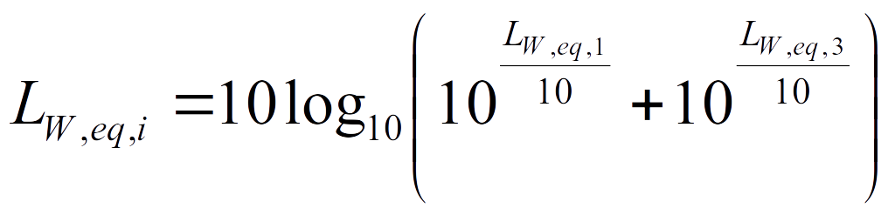
Cnossos
a) Compute the sound power L_{w,eq,i,m} of the highway for the 1/1 octave band range 63-4000 Hz, per vehicle type. Also, compute the total sound power L_{w,eq,i} for the vehicles together.
Answer:
To get the total sound power L_{W,eq,i} for the vehicles together, compute the logarithmic sum of the sound powers per meter:
f | L_{W,eq,i}
(Hz) | (dB)
63 | 83.5
125 | 84.2
250 | 83.8
500 | 85.1
1000 | 90.5
2000 | 88.1
4000 | 80.0
7S0X0
2017/02/09
PAGE <number>

Slide 8
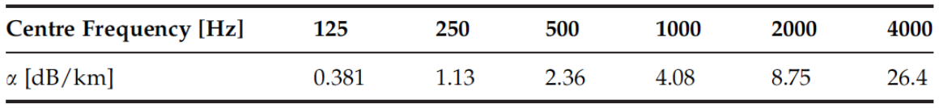
Cnossos
b) Compute the noise level per 1/1 octave band L_{p,i} at the closest façade due to the highway, at a height of 4 m. Make use of figure 1 for computing the ground effect and A_{div} = 10log₁₀(d)+8.
Answer:
Sound power L_{W,eq,i} , we know this as we computed it for last question
Attenuation due to geometrical spreading; here, for a line source,
      A_{div} = 10log₁₀(d)+8 = 28.4 dB (frequency-independent)
Atmospheric absorption A_{atm,i} = α_{i} d/1000 dB , compute with α_{i} from table below
Attenuation due to ground A_{ground,i} , see next slides
Attenuation due to diffraction: A_{dif,i} = 0 dB (no barrier)
7S0X0
2017/02/09
PAGE <number>

Slide 9
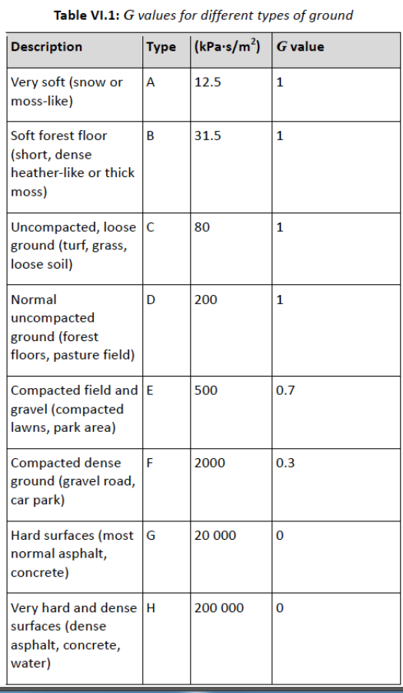
Cnossos
b) Compute the noise level per 1/1 octave band L_{p,i} at the closest façade due to the highway, at a height of 4 m. Make use of figure 1 for computing the ground effect and A_{div} = 10log₁₀(d)+8.
Answer:
Calculation of A_{ground,i}:
Step 1: compute G_{s} and G_{path} based on tabulated values
    Ground near the source = dense asphalt, so G_{s} = 0
    Ground along propagation path = compacted lawn only, so G_{path} = 0.7
    Note: if several ground types are present along the propagation path, you need to compute the weighted average of G_{path} .
7S0X0
2017/02/09
PAGE <number>

Slide 10
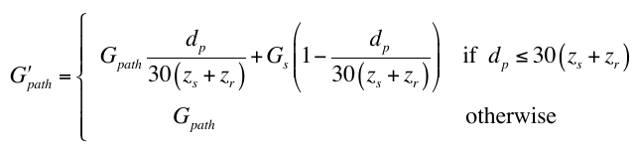
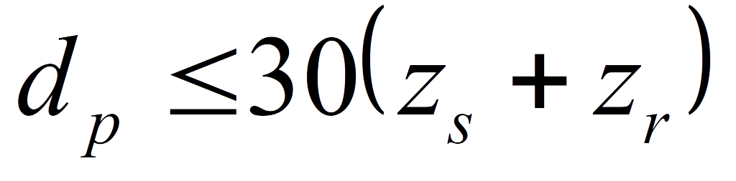
Cnossos
b) Compute the noise level per 1/1 octave band L_{p,i} at the closest façade due to the highway, at a height of 4 m. Make use of figure 1 for computing the ground effect and A_{div} = 10log₁₀(d)+8.
Answer:
Step 2: compute G’_{path} with the formula
Here, d_{p} = 110 m, z_{s} = 0 m and z_{r} = 4 m, so the condition
is true.
We find
7S0X0
2017/02/09
PAGE <number>

Slide 11
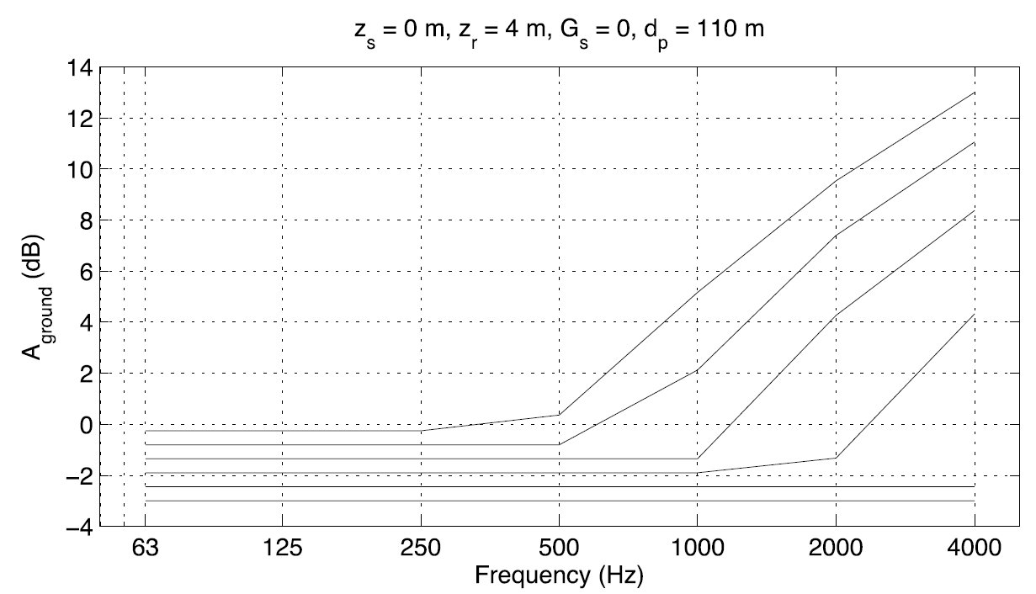
Cnossos
b) Compute the noise level per 1/1 octave band L_{p,i} at the closest façade due to the highway, at a height of 4 m. Make use of figure 1 for computing the ground effect and A_{div} = 10log₁₀(d)+8.
Answer:
Step 3: from the computed value of G’_{path} , you can estimate A_{ground,i} from the provided figure, for each octave band:
f | A_{ground,i}
(Hz) | (dB)
63 | -1.5
125 | -1.5
250 | -1.5
500 | -1.5
1000 | -1.5
2000 | 4.5
4000 | 8.5
7S0X0
2017/02/09
PAGE <number>

Slide 12
Cnossos
b) Compute the noise level per 1/1 octave band L_{p,i} at the closest façade due to the highway, at a height of 4 m. Make use of figure 1 for computing the ground effect and A_{div} = 10log₁₀(d)+8.
Answer:
You can now compute the noise level per octave band:
f | L_{W,eq,i} | A_{div} | A_{atm} | A_{grnd} | A_{dif} | L_{p,i}
(Hz) | (dB) | (dB) | (dB) | (dB) | (dB) | (dB)
63 | 83,5 | 28.4 | 0,0 | -1.5 | 0.0 | 56,6
125 | 84,2 | 28.4 | 0,0 | -1.5 | 0.0 | 57,2
250 | 83,8 | 28.4 | 0,1 | -1.5 | 0.0 | 56,8
500 | 85,1 | 28.4 | 0,3 | -1.5 | 0.0 | 58,0
1000 | 90,5 | 28.4 | 0,4 | -1.5 | 0.0 | 63,1
2000 | 88,1 | 28.4 | 1,0 | 4.5 | 0.0 | 54,2
4000 | 80,0 | 28.4 | 2,9 | 8.5 | 0.0 | 40,1
7S0X0
2017/02/09
PAGE <number>

Slide 13

Cnossos
c) For the same receiver point as b), compute the A-weighted sound level L_{p,A}.
Answer:
Apply the A correction to each octave band, then compute the logarithmic sum of the noise levels:
F (Hz) | 63 | 125 | 250 | 500 | 1KHz | 2KHz | 4KHz
A-weighting correction factor (dB) | -26.2 | -16.1 | -8.6 | -3.2 | 0 | 1.2 | 1
We find L_{p,A} = 64.4 dB(A)
7S0X0
2017/02/09
PAGE <number>

Slide 14
Cnossos
d) In winter time, the ground between the residential area and the road is occasionally covered by snow. How much does the A-weighted sound level L_{p,A} change due to this?
Answer:
With snow the ground absorption will change, so you need to recompute A_{ground,i} :
Now, G_{path}=1, leading to G’_{path} = 0.9
You can thus estimate A_{ground,i} from the figure.
Following the same procedure as before, we find L_{p,A} = 60.0 dB(A),
i.e., a reduction of 4.3 dB(A).
7S0X0
2017/02/09
PAGE <number>

Slide 15
Cnossos
e) To reduce the noise level, a thin 4 m tall barrier is erected at 10 m from the road. At the receiver point of b), compute the reduction in A-weighted sound level L_{p,A} due to the barrier. Make use of figure 2 for this purpose.
Answer:
Now, absorption due to diffraction:
Here, A_{ground,i} = 0 since the ground effect is already included in A_{dif,i} .
Otherwise, the other terms are the same as before.
Let’s now compute the different terms appearing in the definition of A_{dif,i} ,
accounting for diffraction and the ground effects on both sides of the barrier,
respectively.
7S0X0
2017/02/09
PAGE <number>

Slide 16
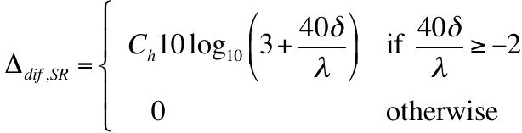
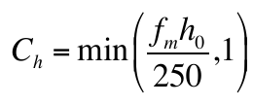
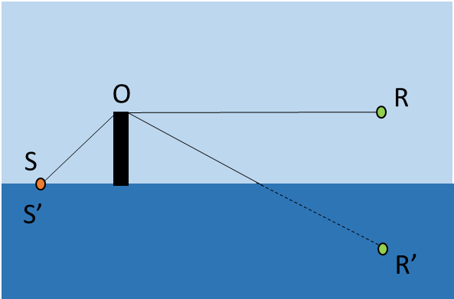
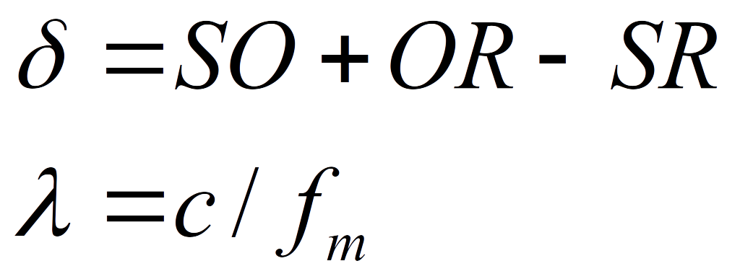
Cnossos
e) To reduce the noise level, a thin 4 m tall barrier is erected at 10 m from the road. At the receiver point of b), compute the reduction in A-weighted sound level L_{p,A} due to the barrier. Make use of figure 2 for this purpose.
Answer:
f_{m}= central frequency of frequency band
h₀= height of the barrier
7S0X0
2017/02/09
PAGE <number>

Slide 17
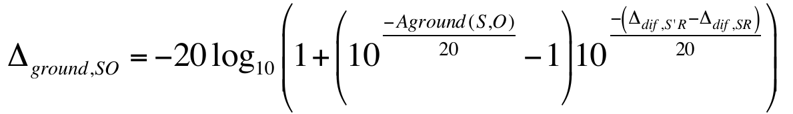
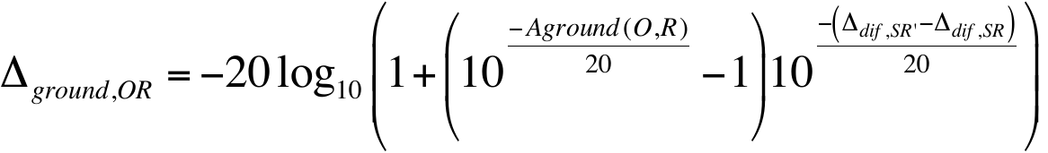
Cnossos
e) To reduce the noise level, a thin 4 m tall barrier is erected at 10 m from the road. At the receiver point of b), compute the reduction in A-weighted sound level L_{p,A} due to the barrier. Make use of figure 2 for this purpose.
Answer:
See the Matlab script for more details on how to compute these two terms
7S0X0
2017/02/09
PAGE <number>

Slide 18
Cnossos
e) To reduce the noise level, a thin 4 m tall barrier is erected at 10 m from the road. At the receiver point of b), compute the reduction in A-weighted sound level L_{p,A} due to the barrier. Make use of figure 2 for this purpose.
Answer:
Once you know the new A_{dif ,}
recompute the
A-weighted sound level:
f | L_{W,eq,i} | A_{div} | A_{atm} | A_{ground} | A_{dif} | L_{p,i}
(Hz) | (dB) | (dB) | (dB) | (dB) | (dB) | (dB)
63 | 84,1 | 28.4 | 0,0 | 0 | 5,3 | 49,8
125 | 84,2 | 28.4 | 0,0 | 0 | 7,6 | 48,1
250 | 83,8 | 28.4 | 0,1 | 0 | 9,9 | 45,3
500 | 85,1 | 28.4 | 0,3 | 0 | 12,7 | 43,8
1000 | 90,5 | 28.4 | 0,4 | 0 | 15,5 | 46,0
2000 | 88,1 | 28.4 | 1,0 | 0 | 18,5 | 40,2
4000 | 80,0 | 28.4 | 2,9 | 0 | 21,3 | 27,3
L_{p,A} = 48.6 dB(A)
7S0X0
2017/02/09
PAGE <number>

Slide 19
Cnossos
f) To even further reduce the noise level, it has been suggested to reduce the speed limit to 100 km/h for the lightweight vehicles. How much would the A-weighted sound level L_{p,A} reduce due to this measure?
Answer: Reducing the speed reduces the sound power level L_{W,eq,i,m} for the lightweight vehicles. Re-calculate the sound power, then as before compute the sound level L_{p,i} , then compute the A-weighted sound level.
 | without speed limit | with speed limit
no snow, no barrier | 64.4 | 63.0
snow, no barrier | 60.0 | 58.7
no snow, barrier | 48.6 | 47.3
A-weighted sound levels (in dB(A)) for the different configurations, with and without the speed limit
Here, reducing the speed limit decreases the noise by more than 1 dB(A),
although the decrease is rather small compared to the barrier.
7S0X0
2017/02/09
PAGE <number>

Slide 20
Questions?
^{m.h.r.cosnefroy@tue.nl}
^{(last chance!)}
7S0X0 / 7W8X0
2017/02/09
PAGE <number>

